Slide 1
NDA 120
ADHD
Special Needs Scouting
Expiration Date
This presentation is not to be used after Dec. 31, 2019.
Obtain an updated version at www.scouting.org/disabilitiesawareness.aspx
Notes:
Dear Speaker:
Please review the notes in the PowerPoint file before you present.
Thank you for your commitment to making Scouting available to all.

Slide 2
Attention-Deficit/Hyperactivity Disorder
The DSM - 5 diagnostic criteria for ADHD is:
A persistent pattern of inattention and/or hyperactivity/impulsivity that interferes with functioning or development as characterized by:
-Inattention
-Hyperactivity and impulsivity
Notes:
Inattention can look like:
overlooks or misses details
difficulty sustaining attention during tasks
does not seem to be listening when spoken to directly
does not follow through on instructions
unorganized, loses things
is easily distracted.
Hyperactivity and impulsivity can look like:
often fidgets or taps hands and feet, constant motion
often leaves seat in situations that require staying seated
runs about or climbs in situations which is inappropriate
unable to engage in or play leisure activities quietly
blurts out, talks excessively, or has difficulty waiting their turn

Slide 3

Characteristics of ADHD
Impulsivity
Hyperactivity
Inattention
The Tip of the Iceberg
Hidden below the surface
Notes:
These are the common observations made of a Scout with Attention Deficit/Hyperactivity Disorder.
We tend to see what is on the surface as behaviors and not knowing what truly underlies which can explain why these Scouts may appear this way. It is important to know and understand why Scouts may be hyperactive, inattentive, or impulsive.

Slide 4

Characteristics of ADHD
Impulsivity
Hyperactivity
Inattention
Physiological
Factors
Coexisting
Conditions
Delayed
Social
Maturity
Weak “Executive Functioning”
Impaired
Sense of Time
Sleep
Disturbance
Not Learning Easily
From Rewards and
Punishment
Low Frustration
Tolerance
Learning
Difficulties
Hidden below the surface
Notes:
Leader: Give Iceberg definition handout

Slide 5
Focus on the Scout’s Strengths!
Energetic
Bright
Creative
Enthusiastic
Flexible
Inquisitive
Notes:
Leader: Engage your participants and ask them to brainstorm more Scout Strengths.
Scouts with ADHD have great attributes too!
Energetic
Engaging
Dramatic
Clever
Bright
Excited
Creative
Eager
Enthusiastic
Easy-going
Unique
Carefree
Exceptional
Inquisitive
Spontaneous
NOTE: Encourage your participants to focus on the strengths!

Slide 6
Getting to know your Scout.
TIP #1
Have a conversation.
Scout’s Strengths
Scout’s Challenges
How the Scout learns best
Notes:
Leader: Give the “Know your scout” handout.
Inform your Leaders that they should have this filled out for every Scout in their unit.

Slide 7
Leaders Need to Know
• Important information about every Scout
Equipment/Assistive Technology needs
Diagnosis/Health issues
Medications
Allergies
Things to avoid
Notes:
Remember to ask Parents/guardians about important information which you will most likely find on the “Know your Scout” form. Always ask, “Is there anything that I didn’t ask you that you feel I should know?”
Some Scouts will require assistive technology or equipment to help them to accomplish various tasks. The parents should be able to share this with you and provide the equipment.
Diagnosis-Health-Medications-Allergies are all overall health concerns that you should be aware of. There are also things to avoid for some Scouts, make sure to ask the parents what those “things” might be.

Slide 8
TIP #2
Work with parents on medications.
Regular medication schedule-why?
Responsibility of prescription medication- who?
If state laws are more limiting, they must be followed.
Notes:
Why:
Regular Medication schedule: Ask the parents to make sure to keep the Scout on their medication schedule including weekends while on Scout outings or away at camp
Who:
A Scout leader, after obtaining all necessary information, can agree to accept the responsibility of making sure a Scout
takes the necessary medication at the appropriate time. You must check with your state regulations on dispensing of medication.
Please refer to the Guide to Safe Scouting.

Slide 9
TIP #3
Work with parents on tips for success.
sensitivity issues?
sleeping issues?
issues with large groups?
Notes:
Ask parents about rules of specific campouts and if there is going to be an issue that we may need to be more proactive with.
Scout sensitivity: Find out from the parents if the Scout has sensitivity to; tone of voice, distractions, noise levels, multiple directions, rigid habits like not wanting to take off a hat.
Leader: Have participants develop a list of different sensitivities that they have experienced with their Scouts (which could also include environment, sensory, etc.)
Sleeping issues: Scouts can not just “shut down the brain” and go to sleep, it may take a Scout with ADHD 45 minutes to an hour or more to fall asleep. They might require a light or earbuds in order to wind down and eventually fall asleep, Scouts with ADHD don’t always wear out after an active day at camp.
Large groups: They may have difficulties following directions in larger groups so you may want to position them closer to the speaker or activity (up front and closer). These Scouts; get lost easily, can’t hear, can’t focus, etc. It is better for them in a smaller group. They may experience an increase of anxiety in the larger crowd as they tend to feel lost. This is out of the Scout’s control.

Slide 10

TIP #4
Time Management
State your expectations
Give a time warning
Break up directions
Notes:
*State the expectation of the task one at a time. If you post all of the schedule, the Scout may be overwhelmed and will not start.
* Try to give the Scout a 5 minute warning for any new or upcoming activity, then give a 2 minute warning, then a 30 second warning (these times can vary depending on the need of the Scout)
*When activities are long or complicated, it may help to:
Repeat directions one-on-one when necessary
Assign a buddy to help him get organized
write down a list of smaller steps, for example, when there is a list of 5 steps, give the Scout the directions one at a time.
Provide a more detailed plan if needed

Slide 11
TIP #5
Complement the Scout whenever you find a genuine opportunity.
Ignore minor inappropriate behavior if it is not dangerous or disruptive.
Try to “sandwich” correction between two positive comments
Give clear and concise limits
Notes:
Tip #5 Compliment the Scout whenever you find a genuine opportunity. Ignore minor inappropriate behavior if it is not dangerous or disruptive.
If you are going to correct a behavior, start with a positive comment and then follow the correction with another positive comment.
Give short and precise limits. Be direct and avoid any lecturing.
Don’t take it personally. Keep your cool. Pick your battles.

Slide 12
TIP #6
Be aware of early warning signs
Fidgety behavior may indicate the Scout is losing impulse control.
Schedule breaks.
Use stations or movement for participation.
Give the Scout a break token to use.
Give a non-verbal or proximity signal to the Scout to focus.
Notes:
Tip #6 Be aware of early warning signs, such as fidgety behavior, that may indicate the Scout is losing impulse control.
When this happens, try to:
schedule breaks,
use stations or movement for participation.
Give the Scout a break token to use; a coin, or break card that the Scout can give to the Leader as a nonverbal cue that he/she needs a break.
Leader: Time permitting, generate a list of ideas of break tokens that would work.
Give a nonverbal signal or proximity control (move close to the Scout) to alert him that he needs to focus.

Slide 13
TIP #7
When you must redirect a Scout,
Speak in a calm voice.
Say, “Tell me what happened?”
Never publicly humiliate a Scout.
Keep your cool.
Notes:
Tip #7 When you must redirect a Scout,
Speak in a calm voice
Say, “Tell me what happened…”(if needed during the interaction, describe the exact situation that was witnessed stating only the facts without any opinionated statements). After the response, state;
What should a Scout do? Scouts with ADHD are very sensitive and you will need to be very careful of your approach.
Never publicly humiliate or embarrass a Scout. Walk up to the Scout, speak calmly and never yell across the group to maintain the dignity of the Scout and Yourself!
Pick your battles. Walk away and have another Leader intervene if you feel too emotionally charged.

Slide 14
TIP #8
When a Scout is starting to become more impulsive or aggressive
Use a yellow card/red card system
for all Scouts playing.
“Cooling off” zone
Provide an alternate activity
Notes:
Tip #8
During active games and transition times, be aware when a Scout is starting to become more impulsive or aggressive (this is not necessarily just a Scout with disabilities that may respond aggressively during games). This is one suggestion to use for all Scouts, you may choose to use something other than cards that works for your unit.
Use a yellow card/red card system for all Scouts playing.
You can provide a yellow card to;
warn the Scout - their behavior needs to be checked
they may need a break and can go to the cooling off zone and then re-enter the activity or game.
If the Scout gets a 2nd card, it is red and they need to;
leave the activity as they may need to go to the cooling off zone and then choose an alternate activity.
Provide a place to cool off. Make sure that the “Cooling Zone” is in an area that is within eyesight of Leaders. You may also need an alternative area depending on where your activity is, the “cooling zone” will change depending on where you are.
After the “cooling zone” you may need to have another activity available for that Scout or Scouts to participate in.

Slide 15

TIP #9
Have Expectations for all Scouts
Expect the Scout with ADHD
to follow the same rules
as other Scouts.
ADHD is NOT an excuse
for uncontrolled behavior.
Notes:
Tip #9
Expect the Scout with ADHD to follow the same rules as other Scouts. ADHD is NOT an excuse for uncontrolled behavior.
Be aware that Scouts with ADHD can become very frustrated, overwhelmed and have anxiety (this can be true of most Scouts in your unit!)
They do not know how to communicate in another way. As you get to know your Scout, you may want to set up accommodations or discussed agreements that work for that Scout in advance.

Slide 16

TIP #10
Offer opportunities for purposeful movement
Leading cheers
Performing in skits
Assisting with demonstrations
Teaching outdoor skills to younger Scouts
Notes:
Tip #10
Offer opportunities for purposeful movement, such as
Leading cheers
Performing in skits
Assisting with demonstrations
Teaching outdoor skills to younger Scouts
Often Leaders are hesitant to put Scouts with ADHD in leading roles because they fear something going wrong, yet this can;
Improve focus,
Increase self-confidence, and
Benefit the pack/troop as a whole

Slide 17
Leader actions that can trigger responses
Remember to use the “Golden Rule”
Beware of some reactions that can have negative responses
Some techniques can also “Backfire”
Notes:
Leader: refer to handout for “Negative Responses/Techniques that backfire”
Ask participants for other examples that may have backfired on them.

Slide 18
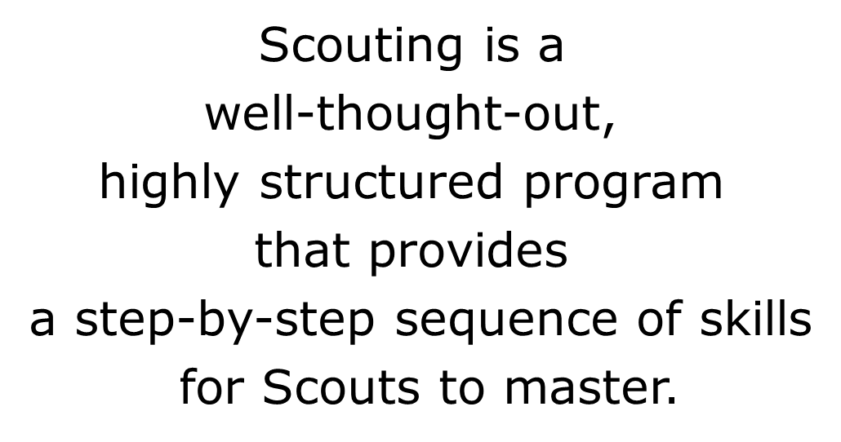
Scouting
Is a Great Program
for Youth With ADHD
Notes:
Utilize time for questions and participant involvement in sharing experiences time permitting after the resources slide

Slide 19
Through systematic Explanation,
interactive Demonstration,
and Guided practice,
Scouting Enables Scouts
with ADHD to discover and develop their
unique strengths and interests.
Notes:
Through systematic Explanation, interactive Demonstration, and Guided practice, Scouting Enables Scouts with ADHD to discover and develop their unique strengths and interests.
Scouting develops social skills and leadership skills.
Scouting offers frequent positive recognition.

Slide 20
Resources:
Scouting.org
http://www.scouting.org/scoutsource/boyscouts/thebuildingblocksofscouting/disabilities.aspx
Children and Adults with Attention Deficit/Hyperactivity Disorder http://chadd.org
Attention Deficit Disorder Association
http://www.add.org
Scouting Magazine
http://scoutingmagazine.org/2013/12/help-scouts-adhd-succeed-without-hurting-anyones-feelings/
Notes:
Resources:
Scouting.org http://www.scouting.org/scoutsource/boyscouts/thebuildingblocksofscouting/disabilities.aspx
Children and Adults with Attention Deficit/Hyperactivity Disorder http://chadd.org
Attention Deficit Disorder Association http://www.add.org
LEADER: Utilize time for questions and participant involvement in sharing experiences time permitting

